Slide 1
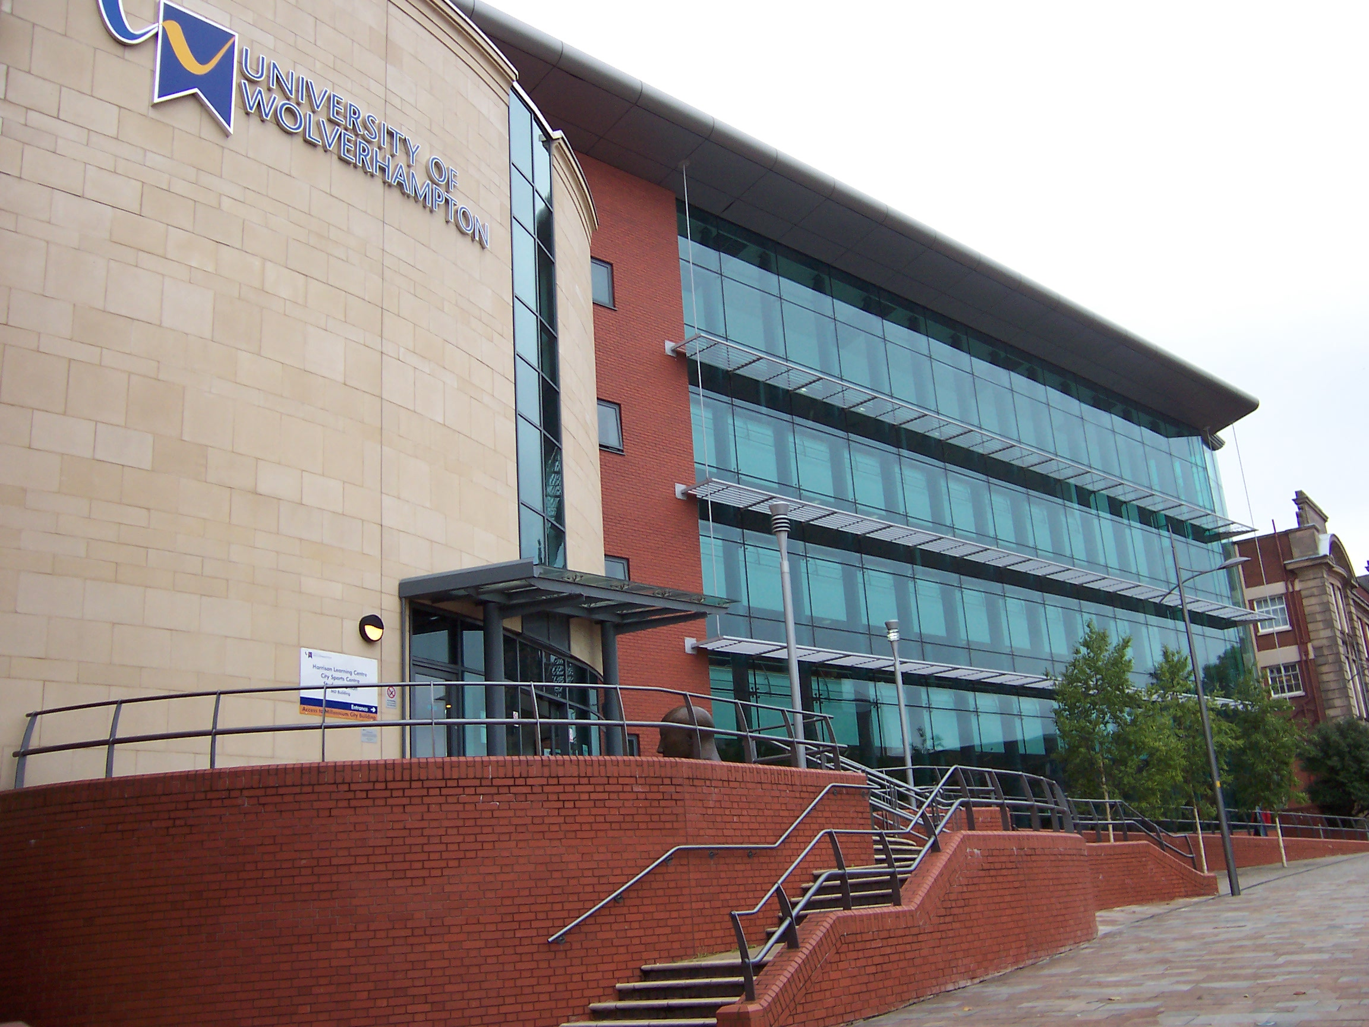
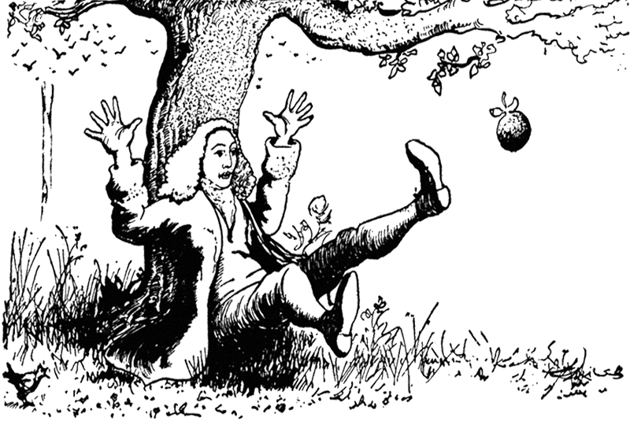
PHYSICS at Wolverhampton
Open Day
Sessions at 10.45 & 13.15
Fabrice Laussy
Director of Studies

Slide 2
Physics is the Art
of Findings Things Out.

Slide 3
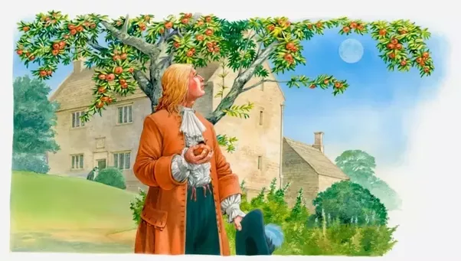

Slide 4
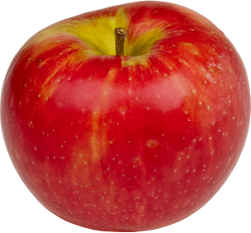

Slide 9
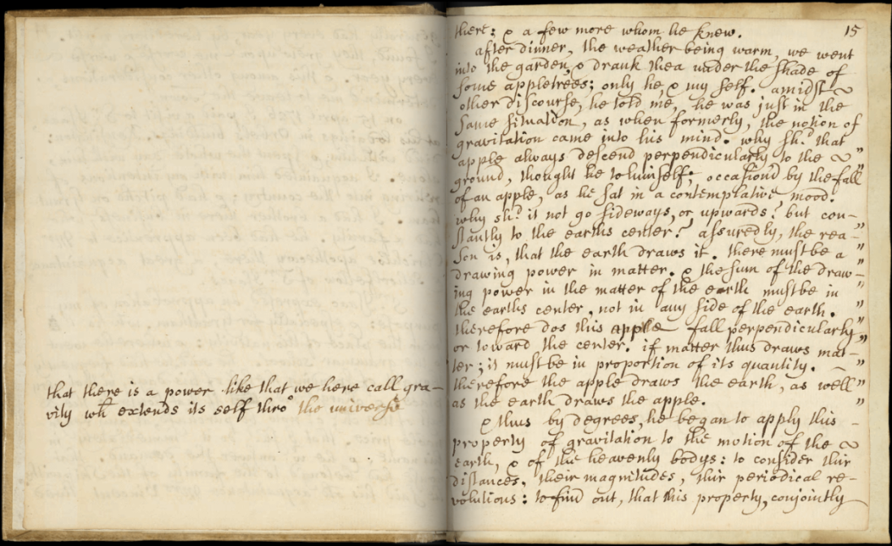
“After dinner, the weather being warm, we went into the garden and drank thea, under the shade of some apple trees...he told me, he was just in the same situation, as when formerly, the notion of gravitation came into his mind. It was occasion'd by the fall of an apple, as he sat in contemplative mood. Why should that apple always descend perpendicularly to the ground, thought he to himself...”

Slide 12
What can I do as a Physicist?

Slide 13
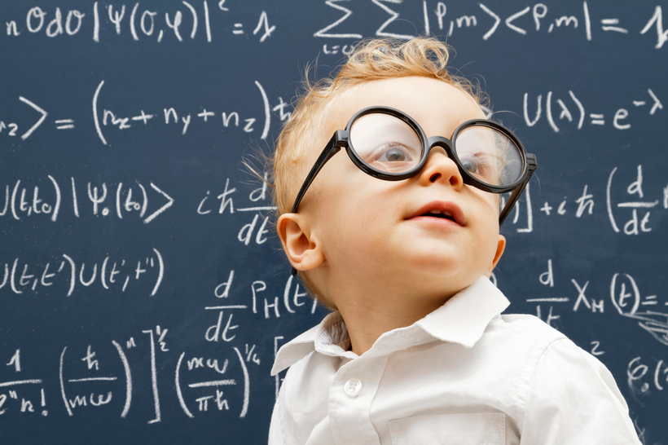
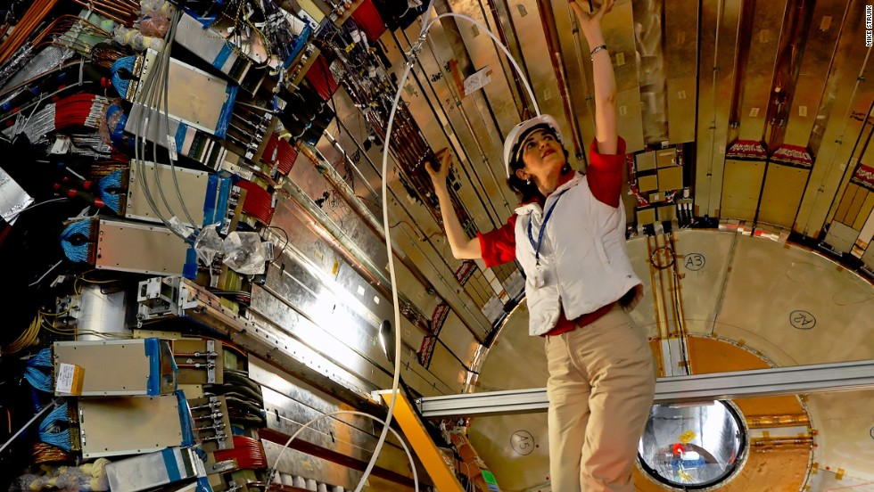
Academia
Theory
Experiment

Slide 14
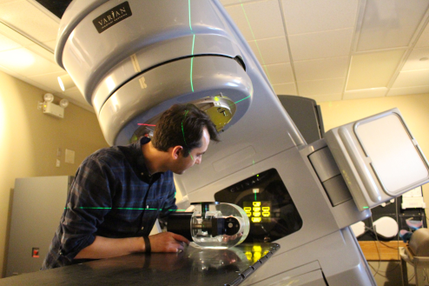
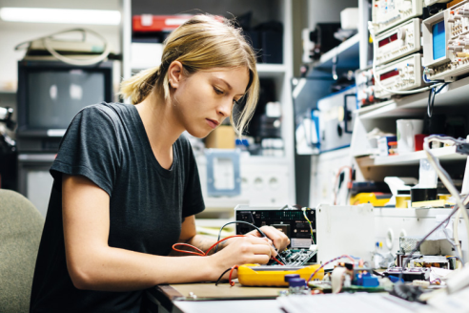
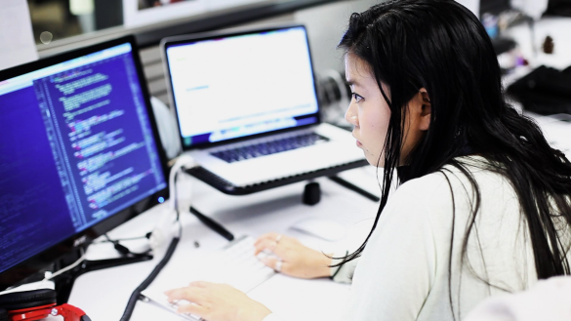
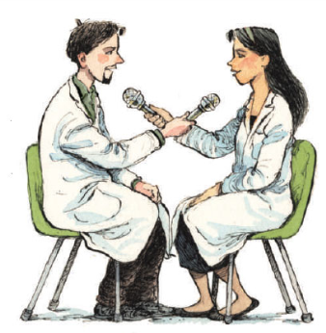
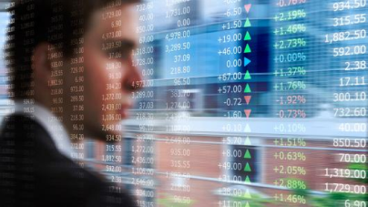
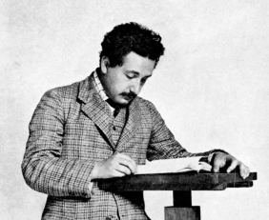
Everything that involves technology
Medical physicist, biophysicist,
optometrist, …
Engineer (Aerospace, Nuclear industry)
Computer scientist, software engineer,
big data
And everything else …
Teacher
Trader, financial analyst
Patent officer
Manager, venture capital
Science journalist, editor

