Slide 1
Rich Exchange Seminar, 25 July 2017
Fabrice P. Laussy – Physics

Slide 2
In “Surely you’re joking Mr Feynman”,
“The questions of the students are often the source of new research. They often ask profound questions that I've thought about at times and then given up on, so to speak, for a while. It wouldn't do me any harm to think about them again and see if I can go any further now. The students may not be able to see the thing I want to answer, or the subtleties I want to think about, but they remind me of a problem by asking questions in the neighborhood of that problem. It's not so easy to remind yourself of these things.”

Slide 3
School

Slide 4
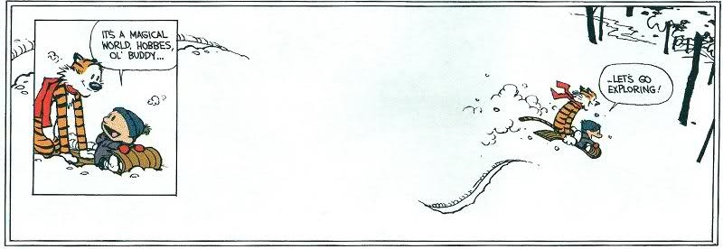
University

Slide 5
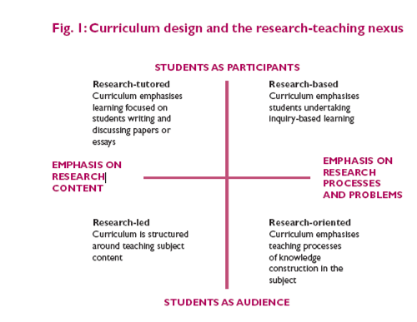
Some trendy teaching methods
Active learning
Research-xxxed learning
Peer-learning

Slide 6
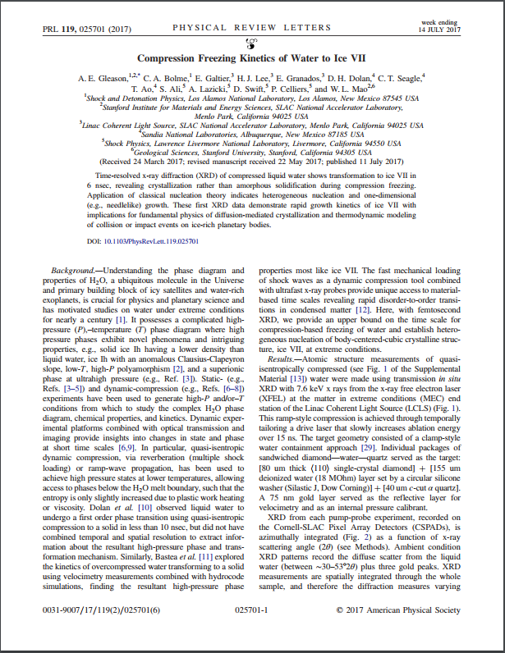
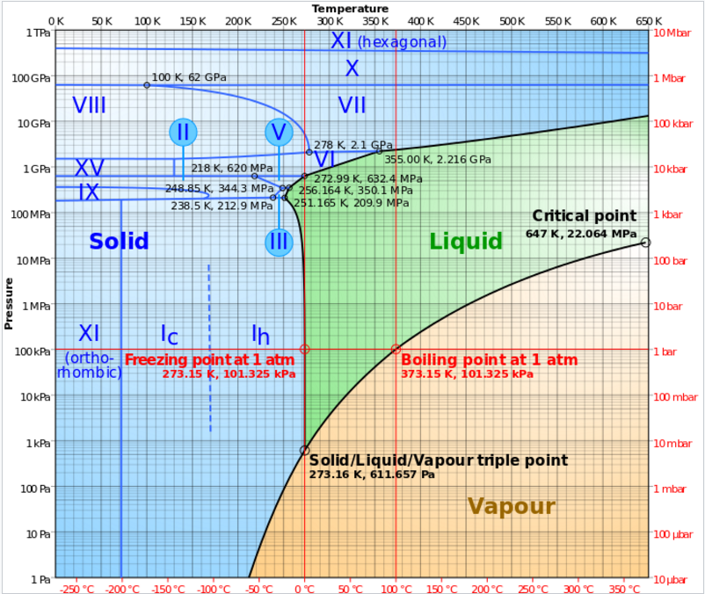
Research-led learning
“Science is magic that works”

Slide 7
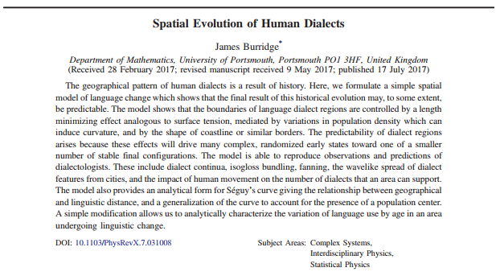

Slide 8
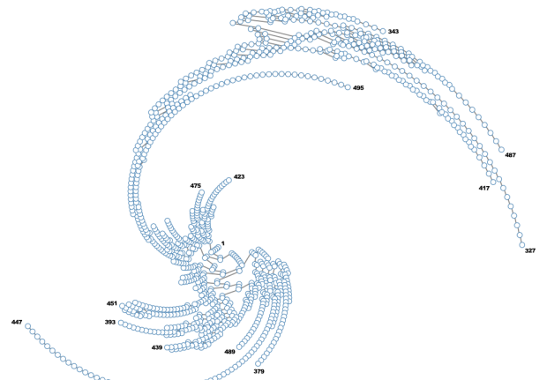
Research-based learning
Teaching of rigorous experimental techniques from Level 1 onwards.
High expectations for assessed laboratory reports. From the start, students are expected to produce reports in the style of professional research articles.
Students undertake inquiry-based learning.

Slide 9
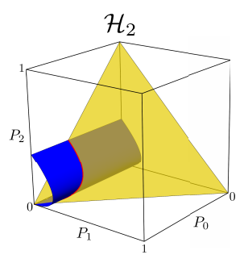

Slide 10
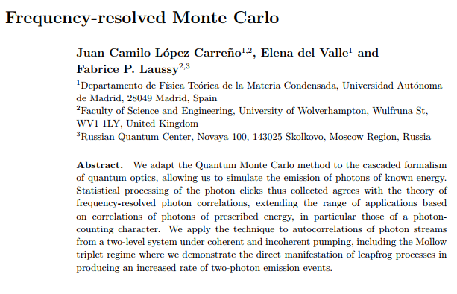
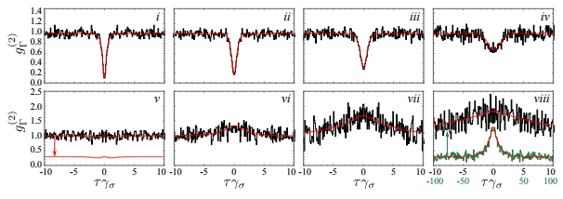

Slide 11
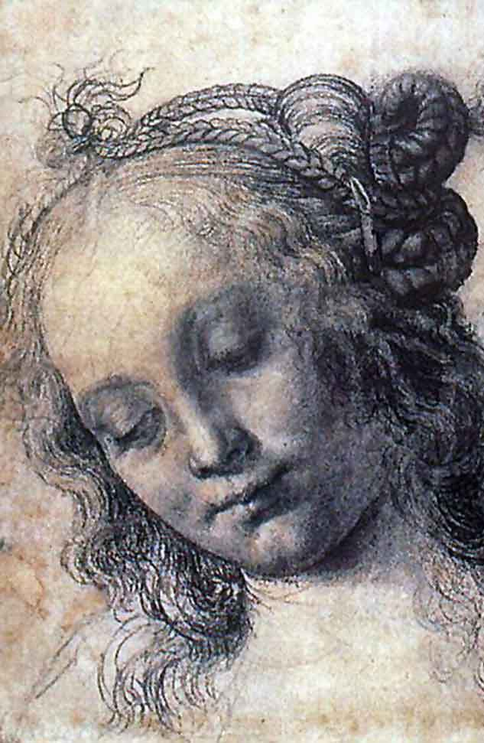
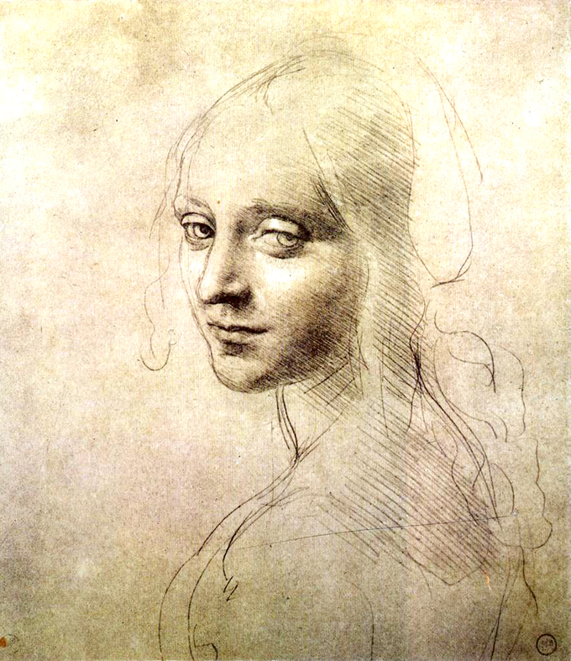

Slide 12
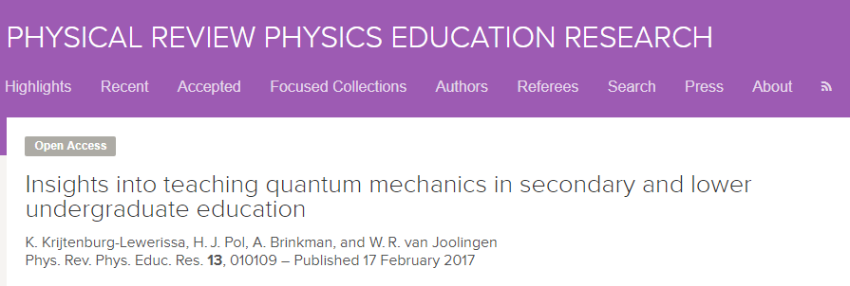
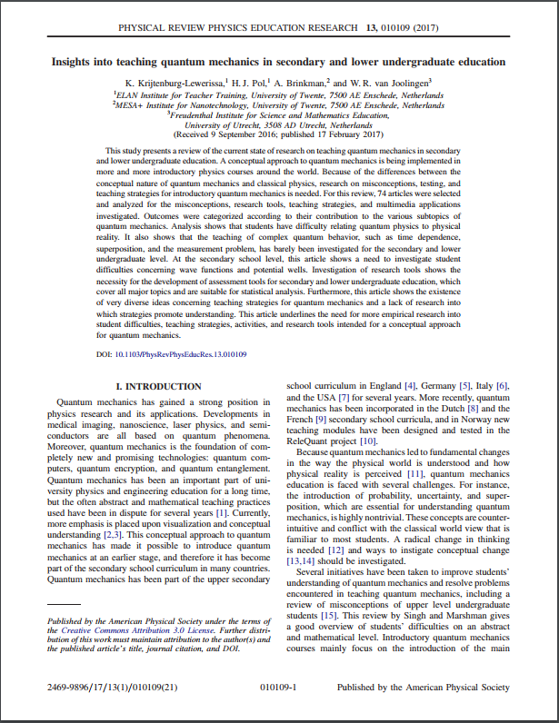
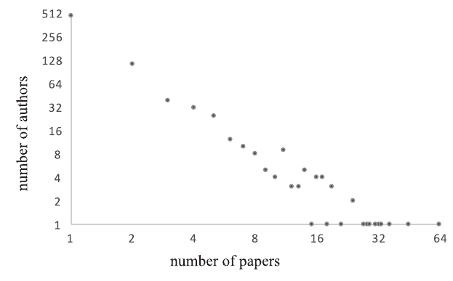
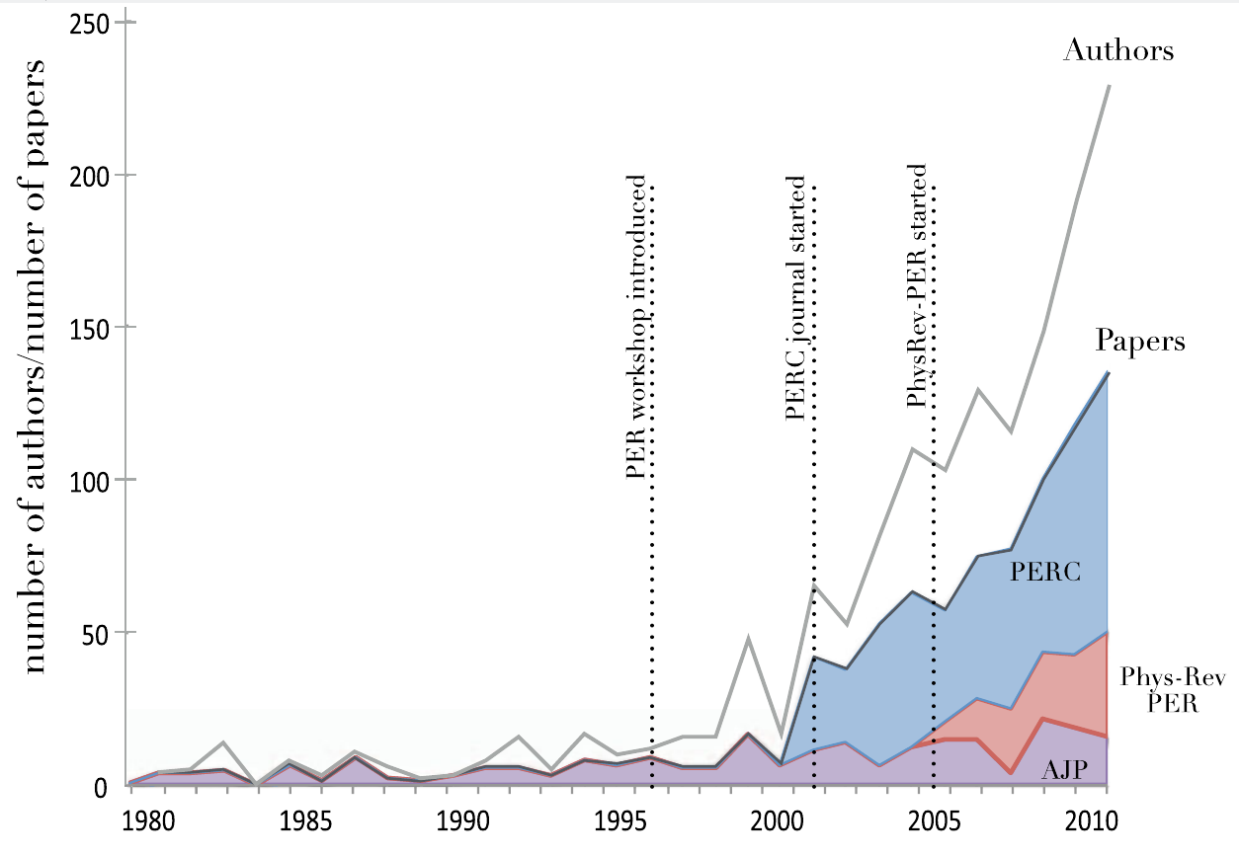

Slide 13
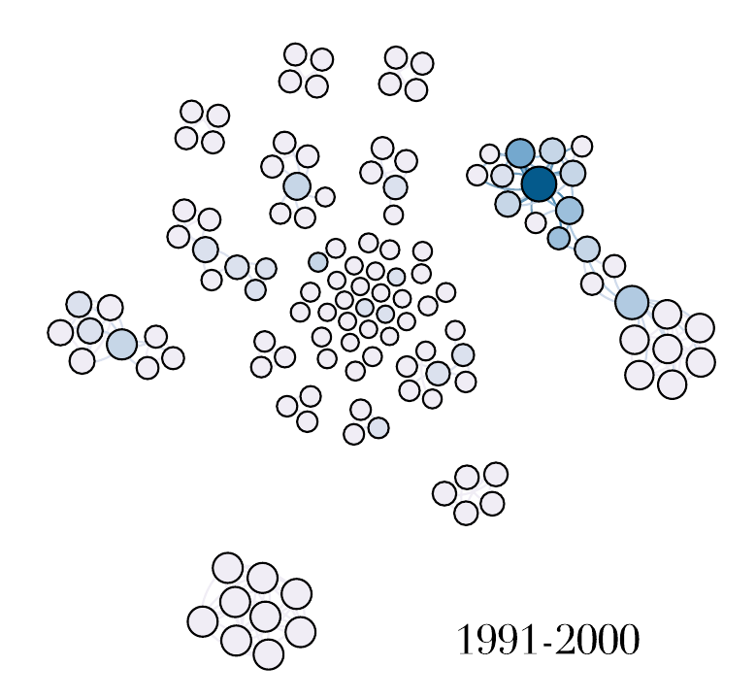
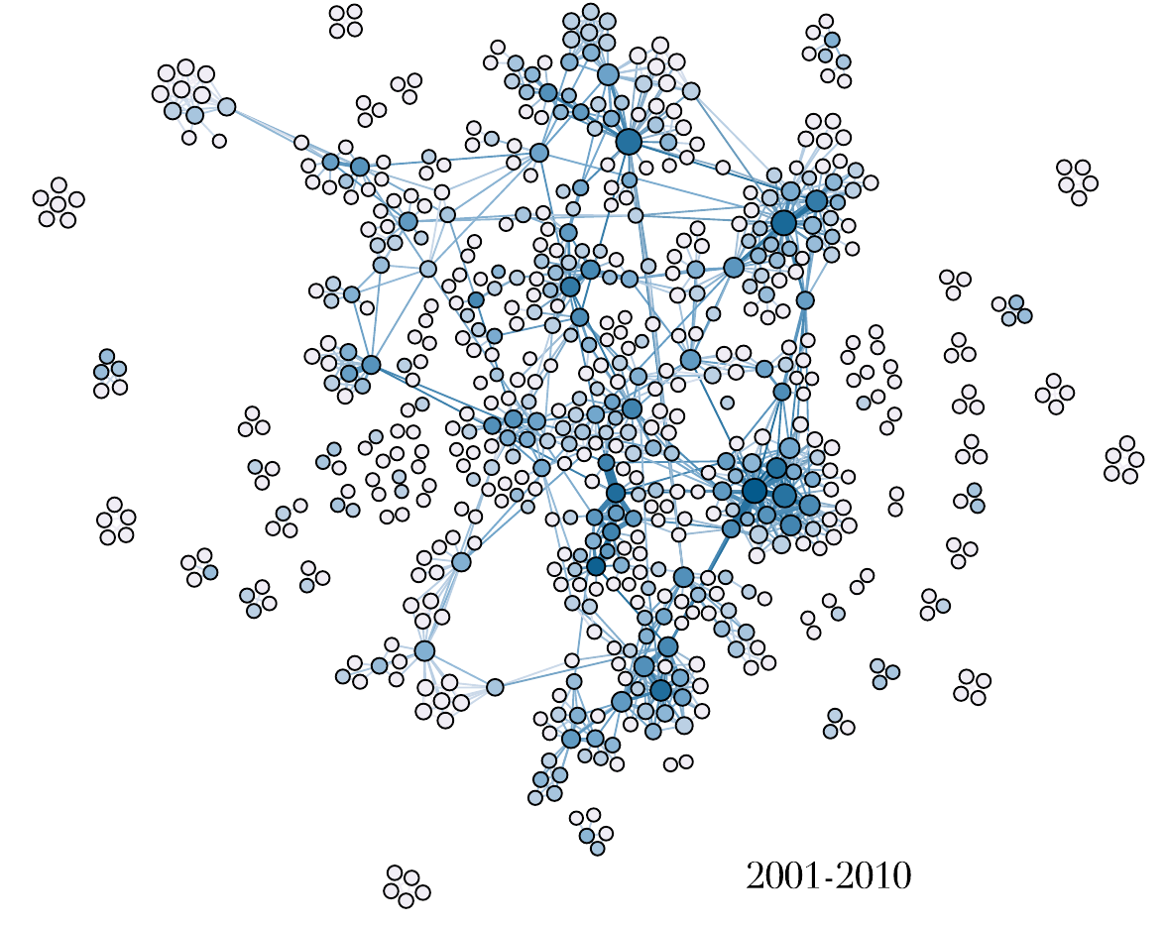
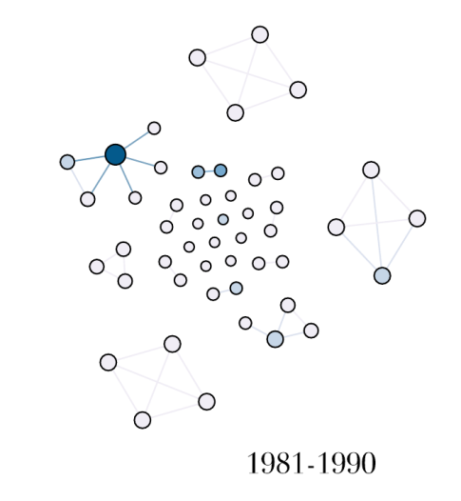

Slide 14
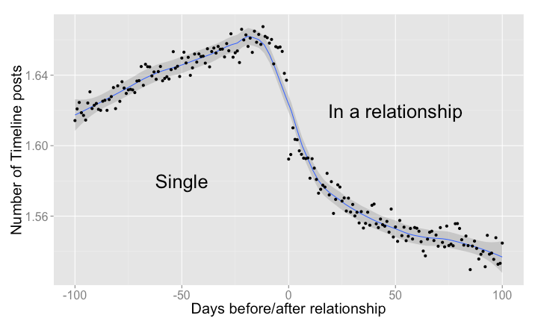
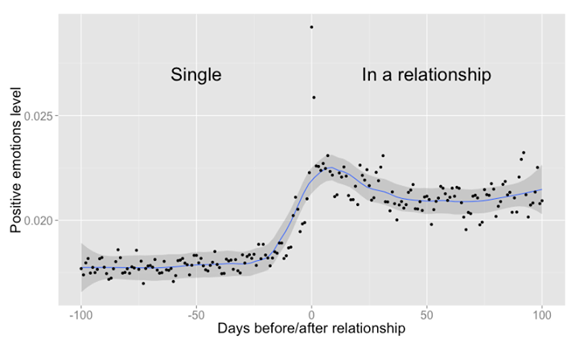
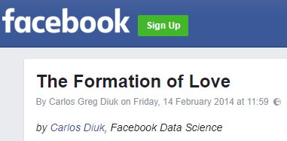
Can we (Wolverhampton) fit in there?
Not too much to do about Physics itself.
Actually pretty much dealing with other fields
(social sciences, statistics, data mining, pedagotical research, etc…)

Slide 15
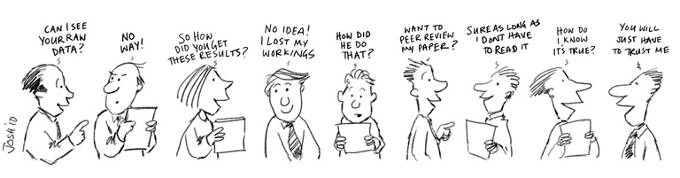
Quality of peer review.
Define/fine-tune metrics to quantify students’ work quality
ELO type system of rating
Follow up of works throughout the years

Slide 16
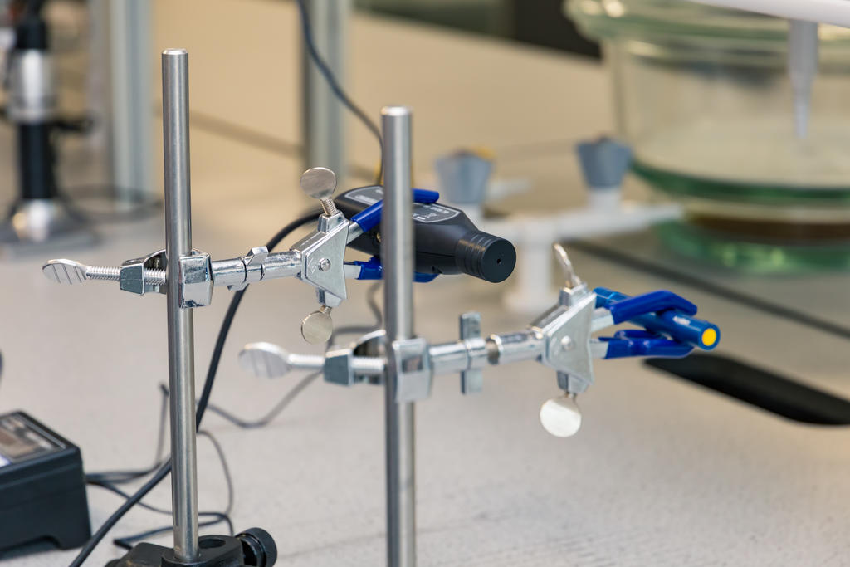

Slide 17
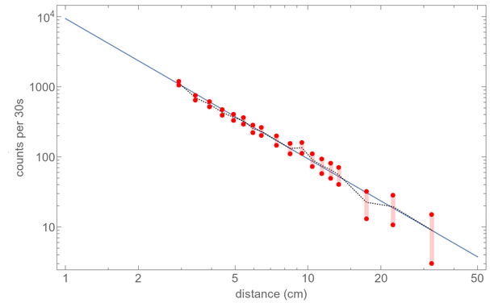
1 – Exploring/applying & studying the teaching of Physics
2 – Benefiting from inquiry-based learning
with Dudley school

Slide 18
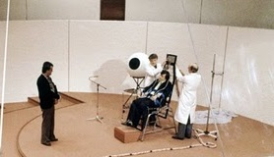
3 - Milgram experiment with classical and quantum mechanics
An authority figure instructs to perform acts conflicting with one’s personal conscience
An authority figure states results conflicting with one’s knowledge and understanding

Slide 19
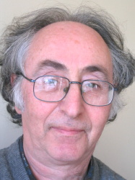
Brian Josephson in the Royal Mail:
“Physicists attempt to reduce the complexity of nature to a single unifying theory, of which the most successful and universal, the quantum theory, has been associated with several Nobel prizes, for example those to Dirac and Heisenberg. Max Planck's original attempts a hundred years ago to explain the precise amount of energy radiated by hot bodies began a process of capturing in mathematical form a mysterious, elusive world containing 'spooky interactions at a distance', real enough however to lead to inventions such as the laser and transistor.
Quantum theory is now being fruitfully combined with theories of information and computation. These developments may lead to an explanation of processes still not understood within conventional science such as telepathy, an area where Britain is at the forefront of research.”

Slide 20
Conclusions
Opening an important branch of STEM, and its starting from scratch, presents a unique opportunity to follow and study the evolution and progress of one of the fundamental university syllabus. There are certainly myriads of things to do, not only for physicists.
If interested/competent where I’m not/curious, please contact me:
f.laussy@wlv.ac.uk

